Slide 1
Lesson 11-1 External Forcing Conditions
CS 185C: Introduction to Numerical Ocean Modeling

Slide 2
Learning Objectives
By the end of this lesson, you should be able to :
List the external forcing conditions pertinent for a numerical model
Create external forcing conditions for your own model
Implement external forcing conditions in MITgcm

Slide 3
External Forcing Conditions

Slide 4
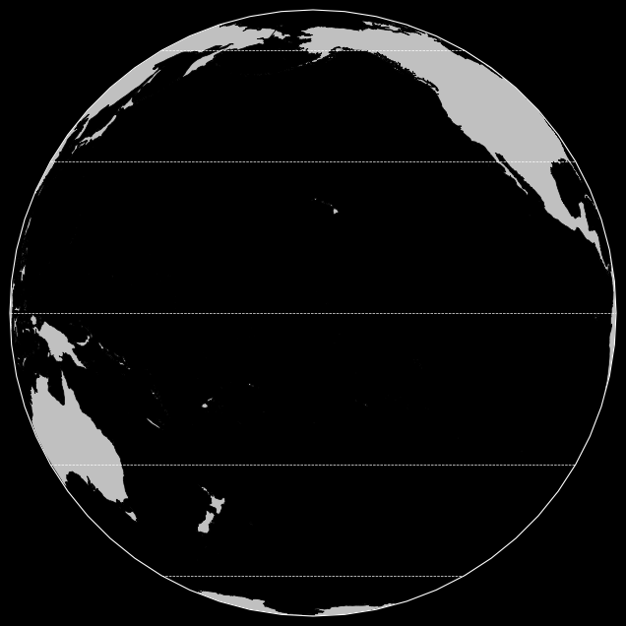
Wind-Driven Ocean Circulation – The Gyres
From Lecture 2-1
1) Atmospheric circulation and Ekman transport move surface currents westward between the equator and 30⁰ …
3) Further effects from Coriolis and “steering” by topography form circulation cells in the northern and southern hemisphere called gyres
2) … and eastward between 30⁰ and 60⁰ …

Slide 5
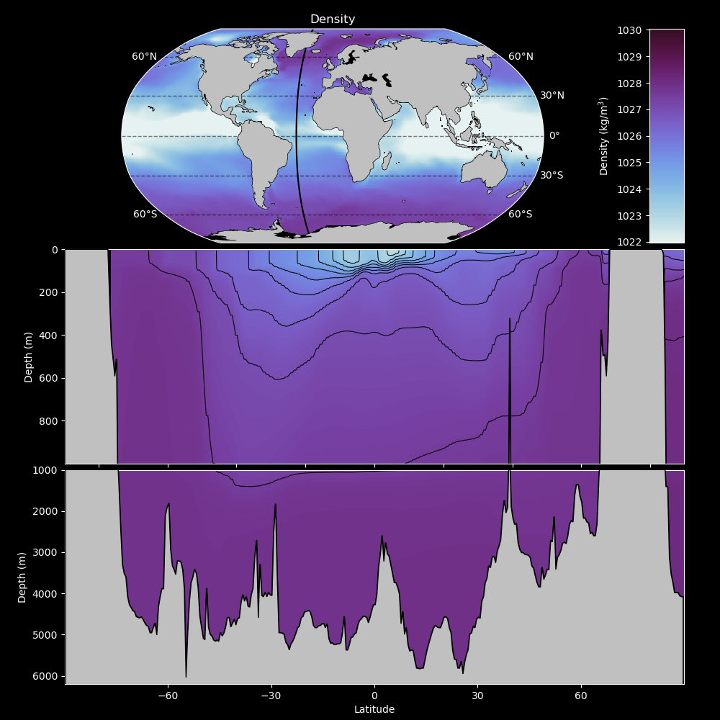

Sinking near the poles
From Lecture 2-2
As water moves north in western boundary currents:
Cooling increases density
Evaporation increases density
Sea ice increases density
Near the poles, surface water is cold, salty, and dense
Water is dense enough to sink $⟹$ 3D Circulation

Slide 6
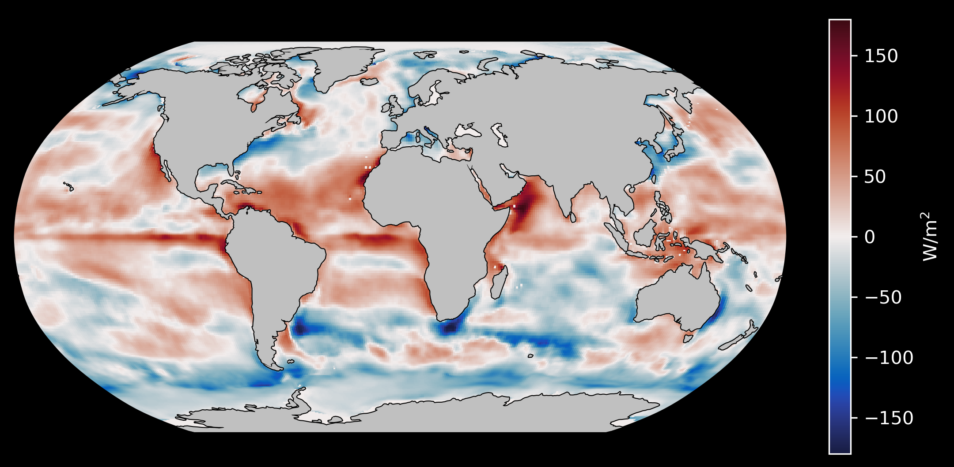
Ocean Heat Uptake
From Lecture 2-2
Near the equator, the ocean uptakes heat (differential heating!)
Temperature increases, density decreases
Near the poles, the ocean loses heat
Temperature decreases, density increases

Slide 7
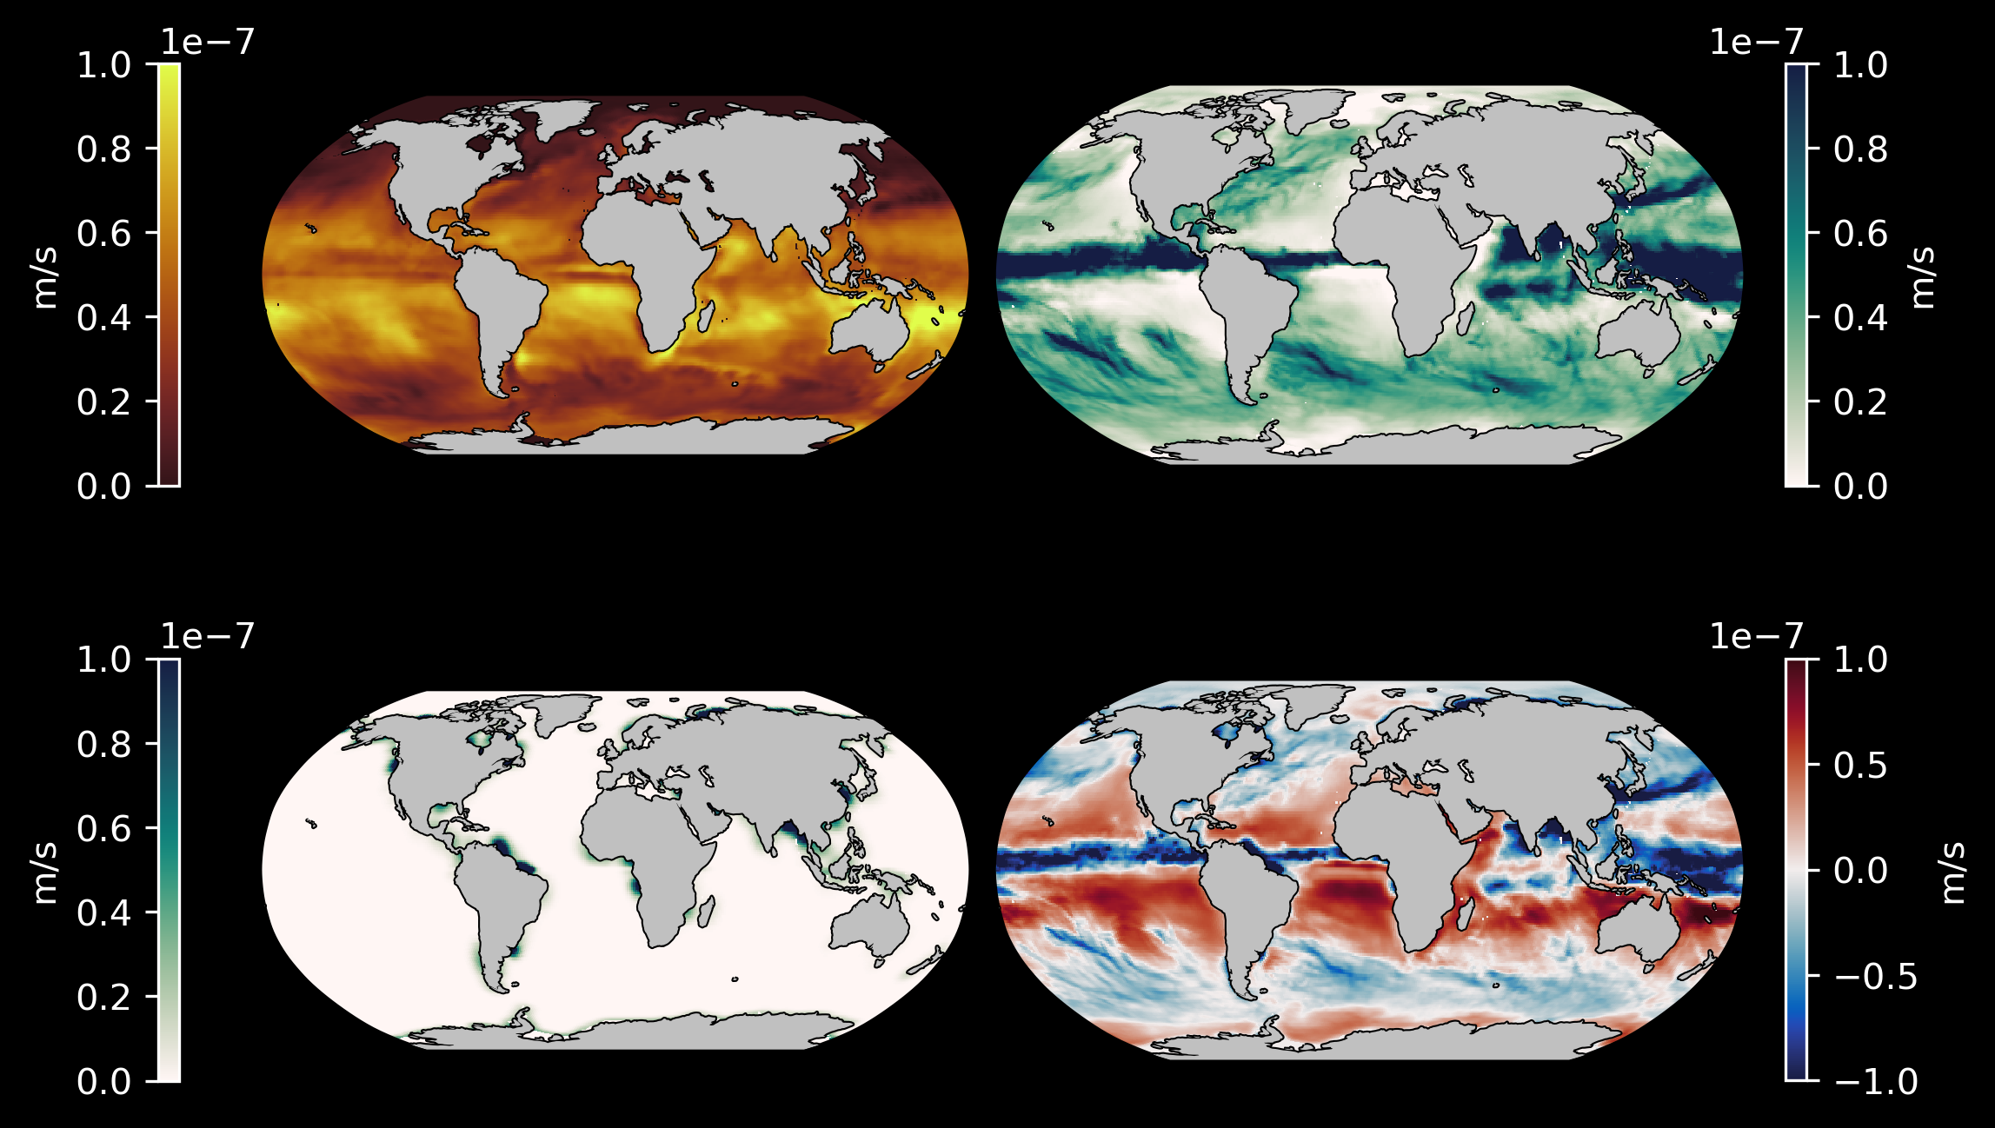
Net freshwater input (E-P-R)
From Lecture 2-2
Evaporation (E)
Precipitation (P)
Near the equator, precipitation outweighs evaporation
In the gyres, evaporation is strong
Western boundary currents typically become saltier as they move north
Runoff (R)
E – P – R

Slide 8
List of Typical Conditions
Field | Impact
Atmospheric Temperature | Modulates heat transport to/from the ocean surface
Humidity | Modulates evaporation from the ocean surface
Shortwave Radiation | Modulates heat transport to/from the ocean surface
Longwave Radiation | Modulates heat transport to/from the ocean surface
Zonal Wind | Drives surface currents (modulates momentum)
Meridional Wind | Drives surface currents (modulates momentum)
Precipitation | Modulates salinity in the upper ocean
Runoff | Modulates salinity in the upper ocean

Slide 9
External Forcing Sources
All external forcing sources are atmospheric variables
For idealized experiments, conditions are generated to approximate general patterns
e.g. the barotropic gyre tutorial
For more realistic experiments, conditions are generated by an atmospheric model (similar to an ocean model)
ECCO uses a reanalysis product that combines real observations with a model to produce a “best guess” for past atmospheric conditions

Slide 10
Implementation in MITgcm

Slide 11
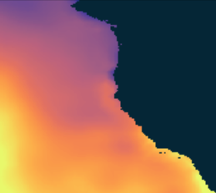
File Format
cols
rows
External forcing conditions are provided in “3D” grids with axes for time, rows, and cols of the model
time

Slide 12
The external forcing package
The exf package provides a flexible way to implement external forcing conditions into a model
Provides flexibility for important information such as:
units (!)
time stepping
file names
interpolation schemes
Designed to be used with the cal package
Assigns model timesteps to a given calendar day, which is helpful for managing files across different years

Slide 13
Pertinent Files
Compile Time
packages.conf
Run Time
data.cal
data.exf
data.pkg

Slide 14
The data.exf file
The exf package provides a flexible way to implement external forcing conditions into a model
The data.exf file specifies 4 namelists to specify certain conditions
Namelist | Purpose
EXF_NML_01 | Set parameters for reading, scaling, and applying external forcing conditions
EXF_NML_02 | Set the file names and start dates for each external field file
EXF_NML_03 | Set scaling parameters for the forcing fields
EXF_NML_04 | Set the spatial interpolation method for each field

Slide 15
The cal package
The cal package can be used to assign dates and times to model time steps
To use, simply specifiy the start date and time of your model (see example on Canvas)

Slide 16
Conditions for Your Model: Two Options

Slide 17
Option 1: Interpolate Regional Conditions
ECCO conditions can be interpolated onto your domain, giving you more control over where the conditions are applied
The Lecture notebook for today demonstrates how to interpolate from ECCO onto your domain
For this option, copy the data.exf_regional file to your namelist directory and save as data.exf

Slide 18
Option 2: Use Global Conditions
ECCO provides external forcing conditions that can be used in your models
MITgcm will interpolate the model parameters onto your grid during run time
For this option, copy the data.exf_global file to your namelist directory and save as data.exf

Slide 19
Update Your Project Files
Whichever option you choose, use this time to update your 4 project files for external conditions on Github now
For this week’s homework, you will provide a notebook to create and plot your conditions and describe the implementation in MITgcm
Consider the following: How many versions of your exf conditions will be needed for your experiment?
e.g. Mike needs 2x wind conditions for his experiment

